Slide 1


Slide 2

School of Computing Science and Engineering
Course Code: BCS01T1001 Course Name: Data Analytics (Excel and Tableau)
Unit 3
Exploring Analysis Tool pack
Faculty Name: Dr.L.Godlin Atlas Program Name: B.Tech

Slide 3
Objective
Histogram
Descriptive Statistics
Moving Average
Exponential
Correlation
Regression

Slide 4
Introduction
Correlation
It is a statistical-based, and thus, mathematics-based information analysis technique.
It consists of analysing the relationship between at least two variables, e.g. two fields of a database or of a log or raw data.
To analyse the relationship between variables, “correlation coefficients” are used.

Slide 5
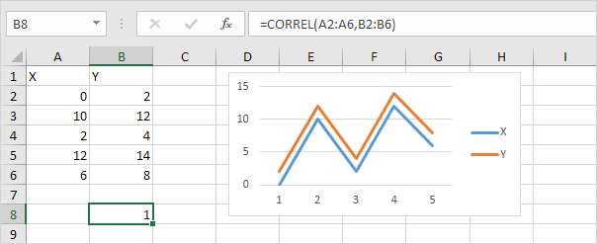
Correlation
The correlation coefficient (a value between -1 and +1) tells you how strongly two variables are related to each other. We can use the CORREL function or the Analysis Toolpak add-in in Excel to find the correlation coefficient between two variables.
A correlation coefficient of +1 indicates a perfect positive correlation. As variable X increases, variable Y increases. As variable X decreases, variable Y decreases.

Slide 6
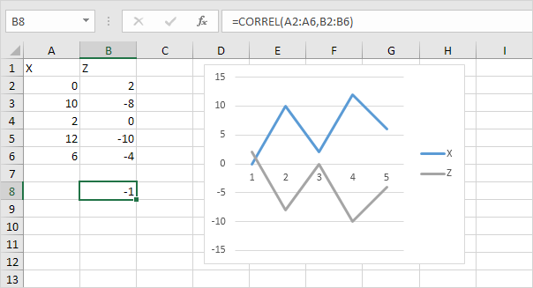
Correlation
- A correlation coefficient of -1 indicates a perfect negative correlation. As variable X increases, variable Z decreases. As variable X decreases, variable Z increases.
- A correlation coefficient near 0 indicates no correlation.

Slide 7
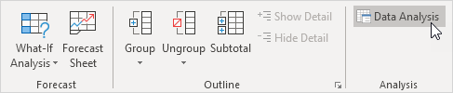
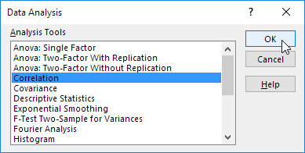
Correlation
To use the Analysis Toolpak add-in in Excel to quickly generate correlation coefficients between multiple variables, execute the following steps.
1. On the Data tab, in the Analysis group, click Data Analysis.
2. Select Correlation and click OK.

Slide 8
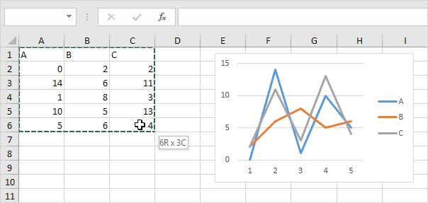
Correlation
3. For example, select the range A1:C6 as the Input Range.

Slide 9
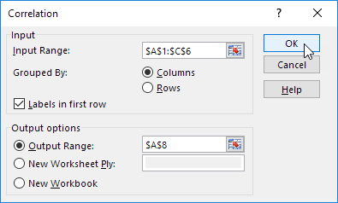
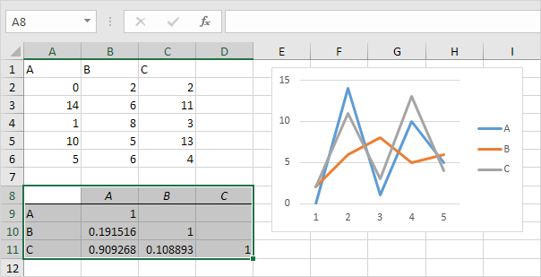
Correlation
4. Check Labels in first row.
5. Select cell A8 as the Output Range.
6. Click OK.
Result

Slide 10
References
Books:
1. Microsoft Excel 2013 Step by Step by Curtis D. Frye; Microsoft Press 2013.
2. Learning Tableau by Joshua N. Milligan,ISBN 139781784391164, PACKT Books - Packt Publishing
Reference Books:
Excel: Quick Start Guide from Beginner to Expert, by William Fischer
Web:
1. https://www.excel-easy.com/examples/correlation.html

Slide 11


